Slide 1
Summer Internship Exposys-DataLabs Bhavesh Raut 2010047

Slide 2
Internship Details
Company Name
Duration
Objective
Outcome
Exposys DataLabs
4 Weeks
The purpose of this project is to send huge bulk mail at a time.
The Knowledge of HTML CSS and JavaScript was used to design MASS MAIL DISPATCHER

Slide 3

“The purpose of this project is to send huge bulk mail at a time. And also it can reduce having invalid mail. This process will save the time. We can perform some following task on this project”
I. Read the CSV file which contain huge no of mail ids.
II. This system can send text, audio, video file using attachment facility.
III. Check whether these CSV exists in system’s file
manager or not, if it doesn’t exist then an error message will be generated.
IV. Read the CSV file and detect the valid mail id and send mail to those mail id’s successfully.
V. The system also detects the invalid mails and stores them into another CSV file for user’s benefit.

Slide 4

What is a Mass Mail Dispatcher?
“Mass-Mail Dispatcher is a system is use to send a bundle of bulk mails to number of recipients at a time. Now days it is very popular to send mails to huge recipients quickly. Now days every company can add this system with their website.”
Features:-
•Most Functionality: Easy way to send bulk mail to huge recipients.
•Send multi-media File: As well as send bulk mails we can
also easily send multi-media file (Audio, video, word file etc.) with attachment.
•Fastest pace of innovation: Now a days this process is made a fastest process for sending bulk mails to huge recipients at a time.

Slide 5



Technologies Learned
HTML
CSS
JavaScript

Slide 6
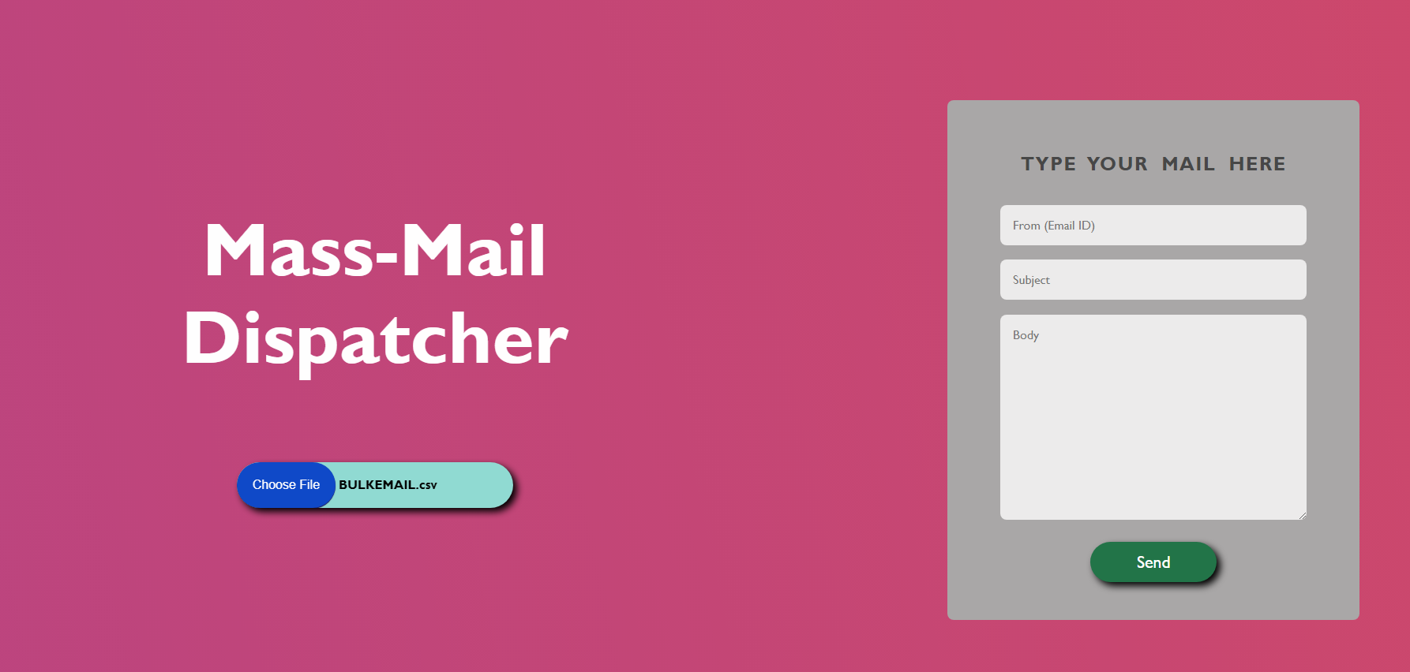
Technologies Applied

Slide 7
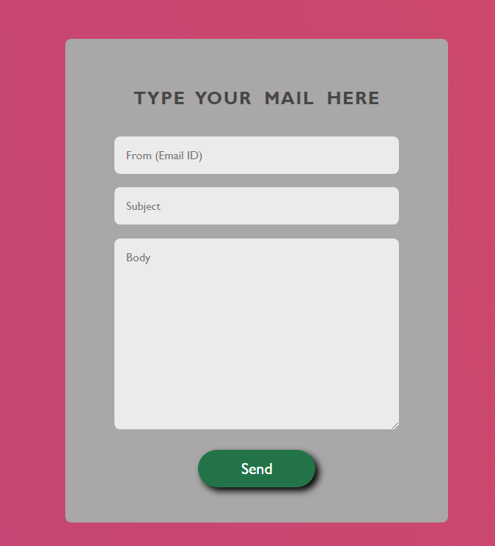
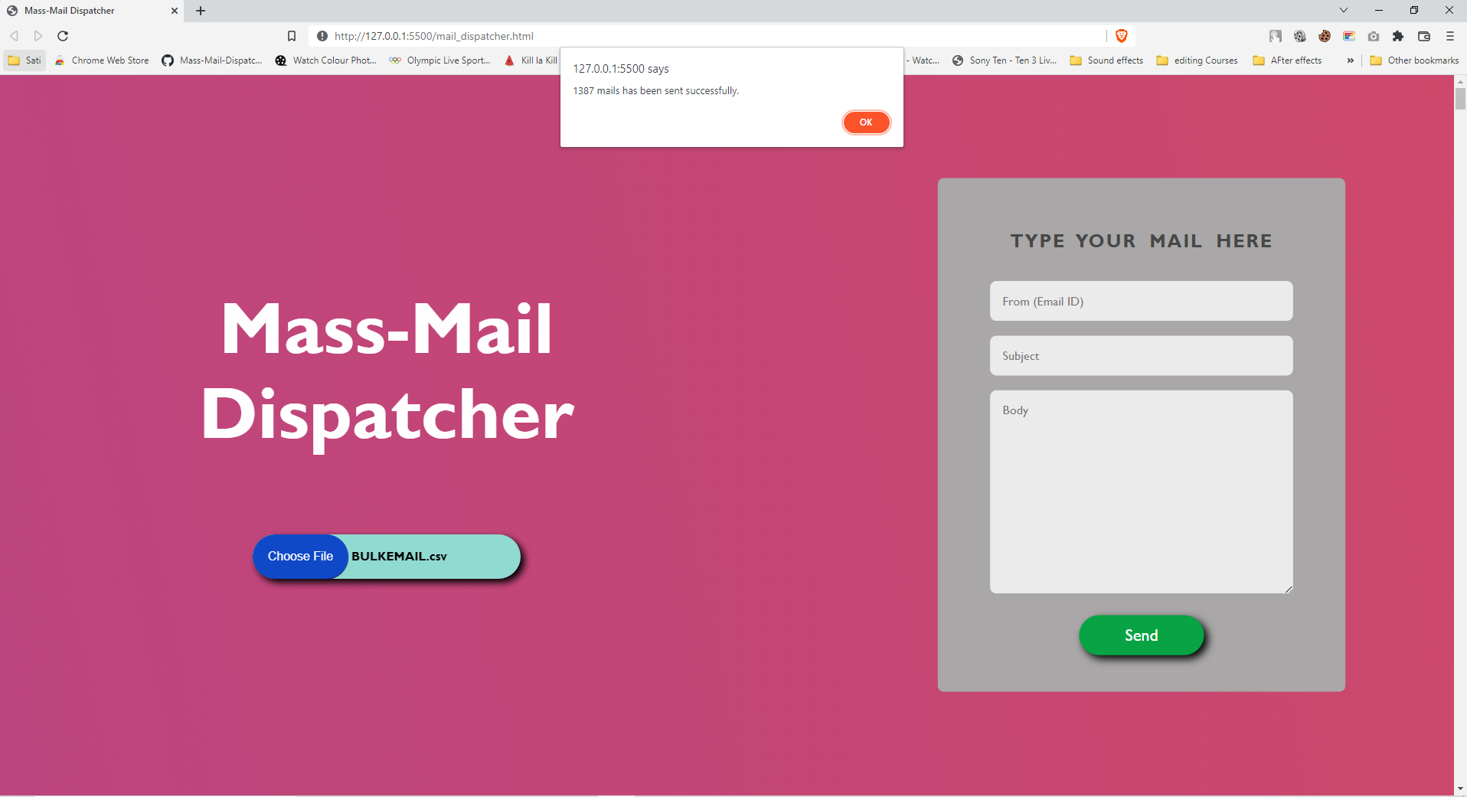
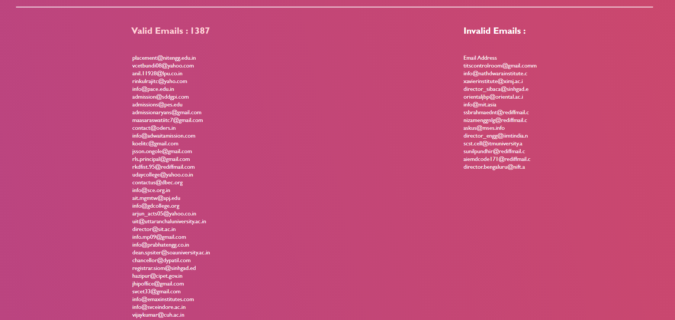
Screenshots Of Project

Slide 8
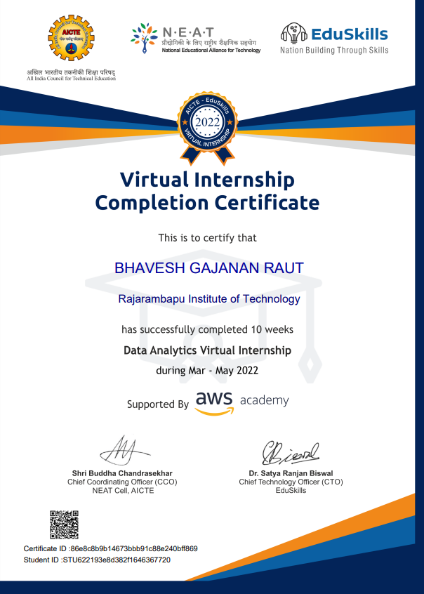
Other Courses Completed
Virtual
Internship
in
Data Analytics by AWS

Slide 9
Thank You
Thank You

